Slide 1



Generative AI with LLM
Florian Bastin
👨🏼‍🎓 Master MASH - Université PSL
👨🏼‍💻 LLM Engineer @OctoTechnology
Le Monde, Casino, Channel, Club Med, Pernod Ricard, Suez

Slide 2
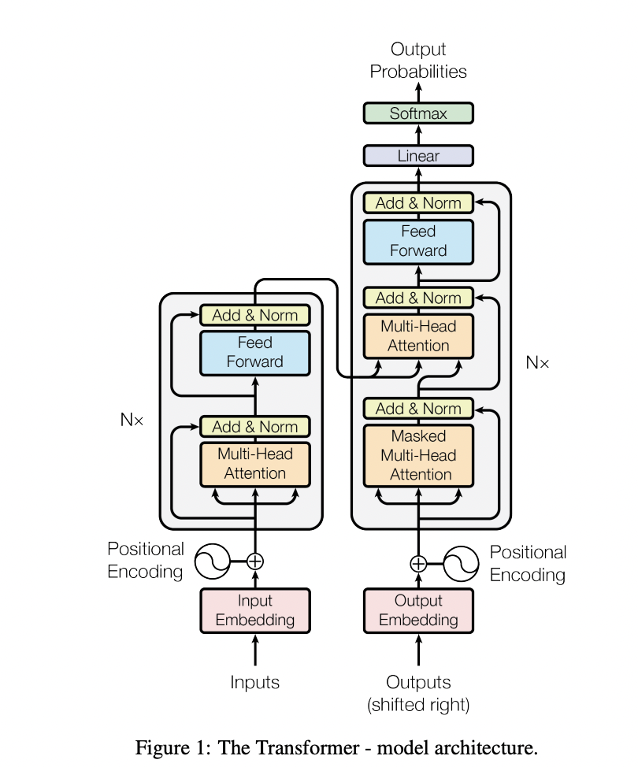

II.B. Transformers Architecture

Slide 3
II.B. Transformers Architecture
Introduction
Self Attention / Cross Attention
Multi-Head Attention
Residual connection & Layer normalization
Feed forward layer
Softmax Layer
Positional Embeddings

Slide 4
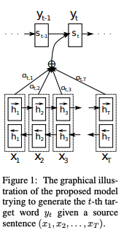
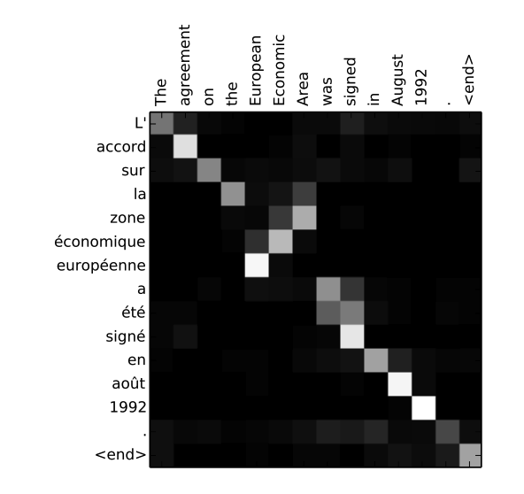
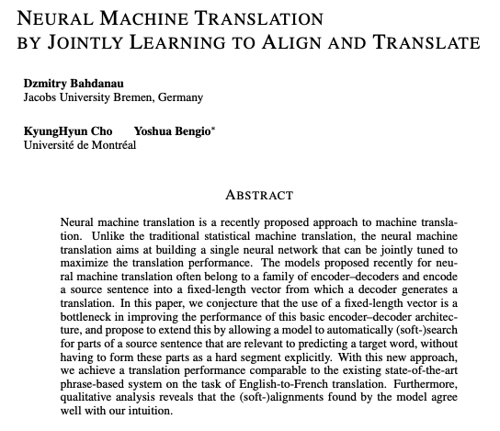
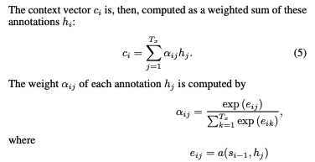
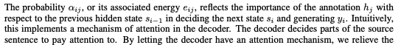
II.B Introduction
Bahdanau & Al, 2016, Neural Machine Translation by Jointly Learning to Align and Translate
Notes:
Dans le decoding on est autoriser a regarder certains mot de l’encodeur
C’est la première fois qu’on parle de recherche d’attention.
Context vector that comes from the encoder is the Weighted sum of the hidden state of the words in in the encoder
and the weight of this sum comes from the softmax based on this compatibility between the current state as you decoding and the hidden state in the encoding

Slide 5
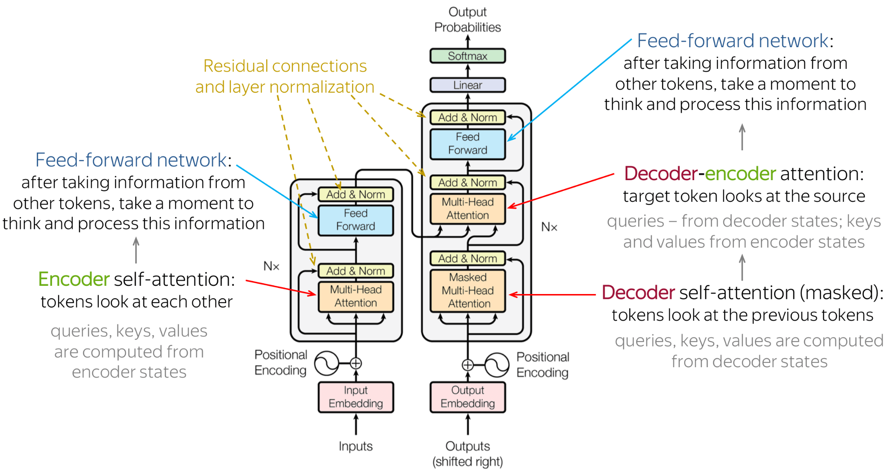
II.B Introduction

Slide 6
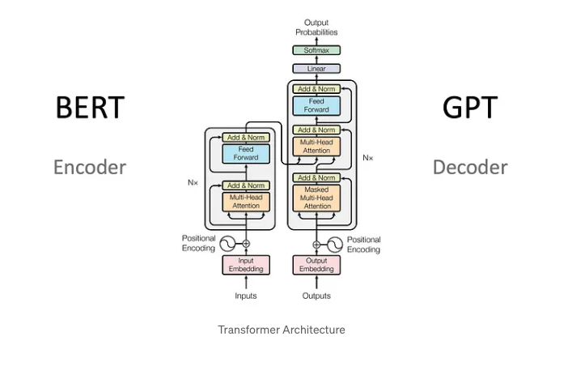
II.B Introduction

Slide 7
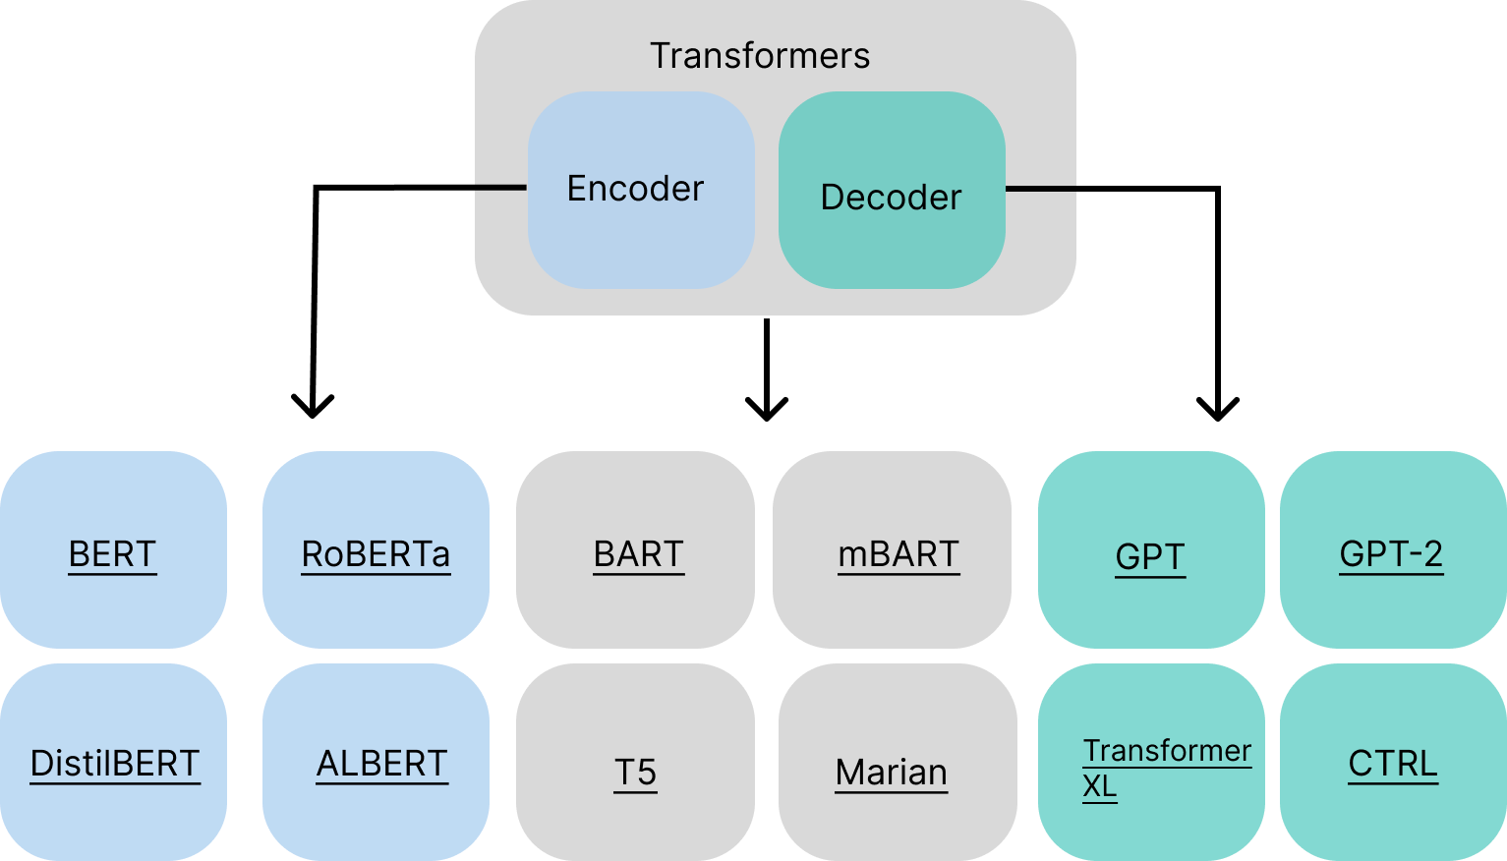
II.B. Introduction

Slide 8
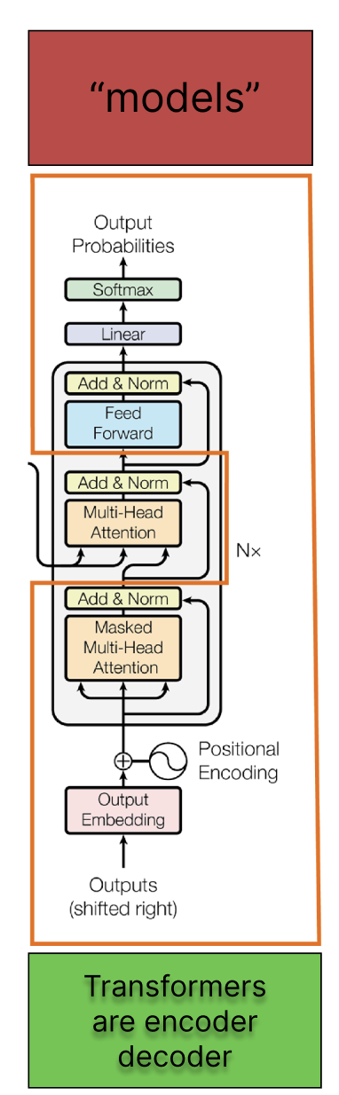
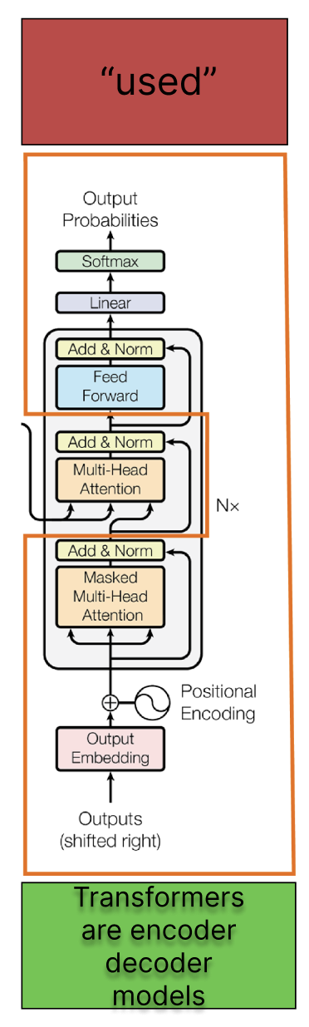
II.B. Introduction
GPT 3
Each word is generated one by one
Only the decoder part is used

Slide 9
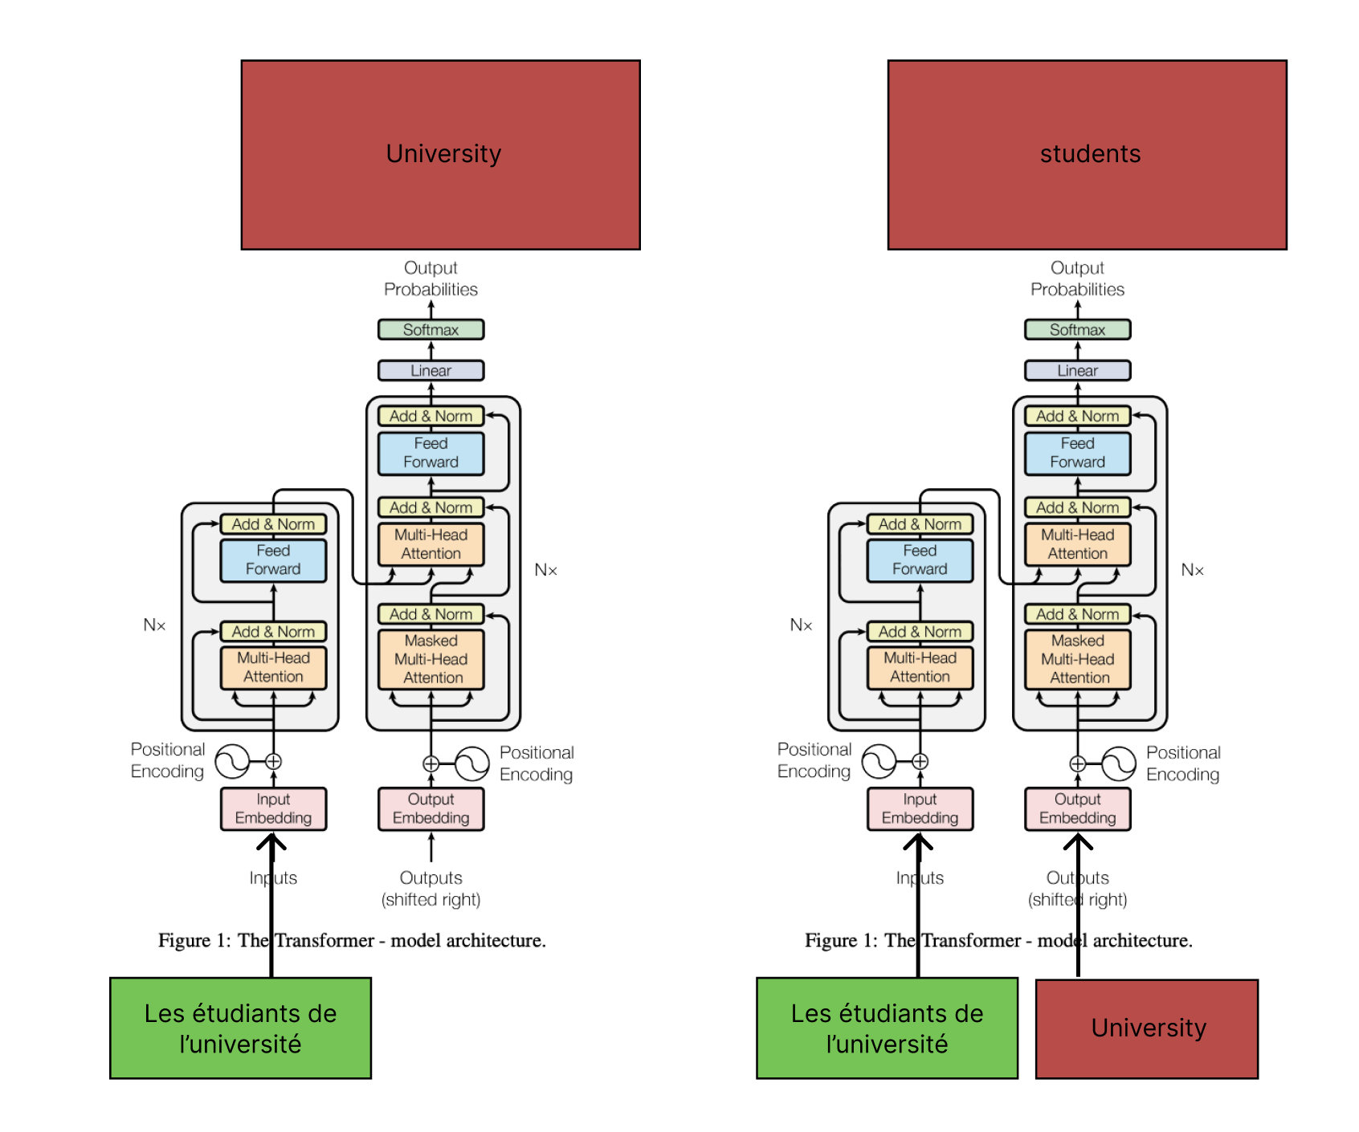
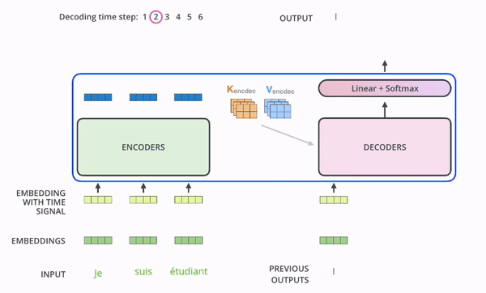
II.B. Introduction
Translation model (FR -> EN example)
The sentence to translate given to the encoder
Each generated word added to the decoder
Jay Allamar, 2019, The Illustrated Transformer

Slide 10
II.B Introduction
Lot of new knowledges in this paper:
No more RNN, only attention
MLP layers and Attention
Positional encodings
ResNet structure
Parallelism with Multi Head Attention
Notes:
Dans le decoding on est autoriser a regarder certains mot de l’encodeur
C’est la première fois qu’on parle de recherche d’attention.
Context vector that comes from the encoder is the Weighted sum of the hidden state of the words in in the encoder
and the weight of this sum comes from the softmax based on this compatibility between the current state as you decoding and the hidden state in the encoding

Slide 11
II.B. Transformers Architecture
Introduction
Self Attention / Cross Attention
Multi-Head Attention
Residual connection & Layer normalization
Feed forward layer
Softmax Layer
Positional Embeddings

Slide 12
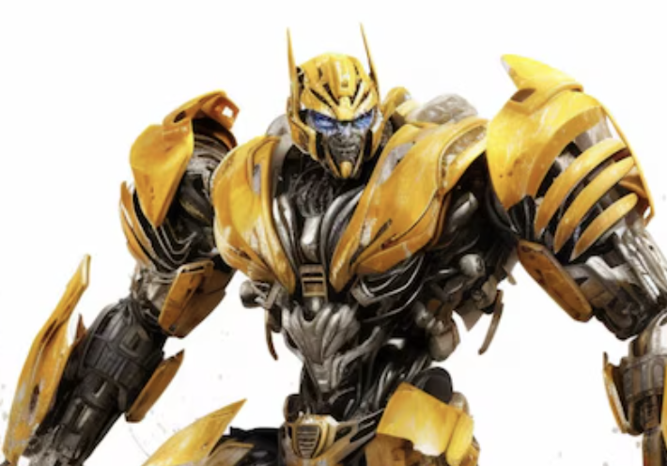
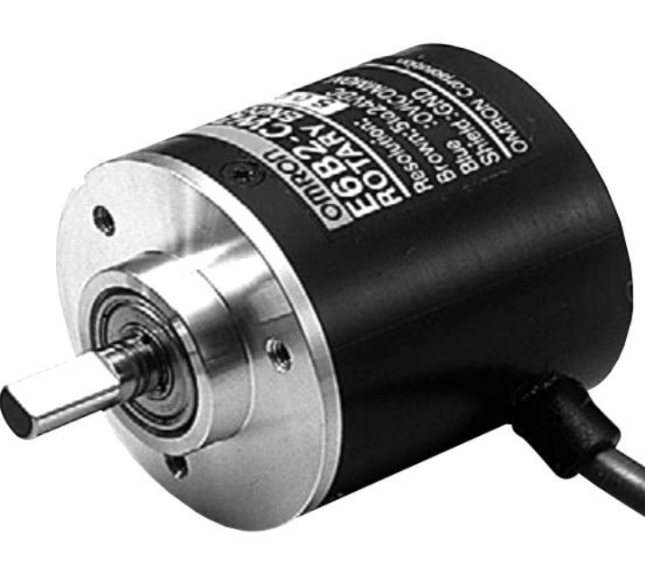


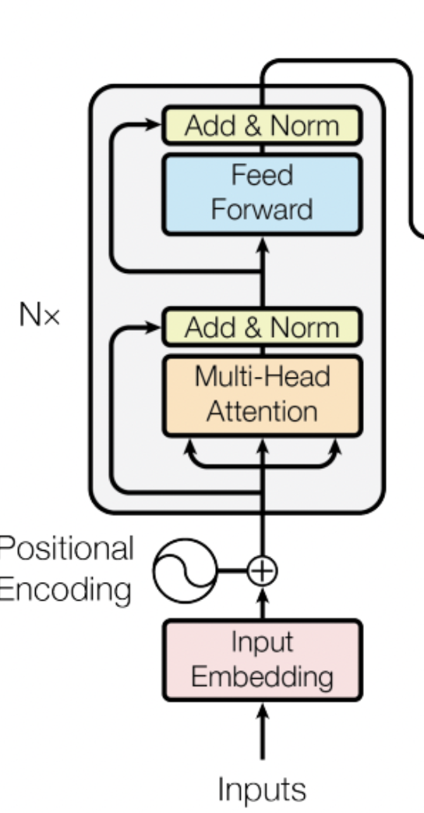
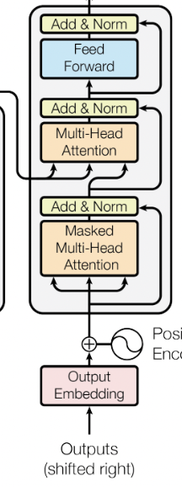
II.B.1 Self Attention Mechanism
Transformers
are
encoder
decoder
Attention mechanism

Slide 13

II.B.1 Self Attention Mechanism
3 components:
Query: What am I looking for ?
Key: What do I have ?
Value: What do I reveal to others ?
Attention mechanism

Slide 14
II.B.1 Self Attention Mechanism
Transformers
are
encoder
decoder
Query: What am I looking for ?
|E| : Embedding (1, 12 288)
|W_{Q}|: Query matrix (12 288, 128)
2.11
-4.22
..
..
5.93
2.43
-3.2
..
..
3.32
2.11
-4.22
..
..
1.12
3.11
-4.22
..
..
4.98
W_{Q}
Embedding
3.23 | -1.23 | 0.89 | 0.32
-3.29 | 3.23 | 1.23 | -2.34
1.83 | 1.92 | 0.10 | 1.28
E₁
E₂
E₃
2.11
-4.22
..
..
5.93
2.11
-4.22
..
..
5.93
2.11
-4.22
..
..
5.93
2.11
-4.22
..
..
5.93
Query
Q₁
Q₂
Q₃
Q₄
Am I a superstar ?
Do I mean Allocation de Retour à l’Emploi ?
…
Are we talking about TV ?

Slide 15
II.B.1 Self Attention Mechanism
W_{K}
1.23 | -1.23 | 0.89 | 1.12
2..29 | 3.23 | -3.23 | -3.34
2.83 | 0.92 | 1.10 | 4.28
Key: What do I have ?
|E| : Embedding (1, 12 288)
|W_{K}|: Query matrix (12 288, 128)
2.11
-4.22
5.93
-3.11
2.422
7.93
I am a noun, starting the sentence
E₁
K₁
Embedding
KEYS
2.43
-3.2
3.32
2.11
-3.22
5.93
I am a verb
E₂
K₂
2.11
-4.22
1.12
2.11
-1.2
5.93
…
E₃
K₃
3.11
-4.22
4.98
-21
42.21.2
1.23
Might be a TV object of a model
E₄
K₄

Slide 16
II.B.1 Self Attention Mechanism
Transformers
are
encoder
decoder
2.11
-4.22
5.93
2.43
-3.2
3.32
2.11
-4.22
1.12
3.11
-4.22
4.98
Embedding
E₁
E₂
E₃
E₄
2.11
-4.22
5.93
2.11
-4.22
5.93
2.11
-4.22
5.93
2.11
-4.22
5.93
Query
Q₁
Q₂
Q₃
Q₄
W_{Q}
2.11
-4.22
5.93
-3.11
2.422
7.93
Am I a superstar ?
Do I mean Allocation de Retour à l’Emploi ?
…
Are we talking about TV ?
3.23 | -1.23 | 0.89 | 0.32
-3.29 | 3.23 | 1.23 | -2.34
1.83 | 1.92 | 0.10 | 1.28
E₁
K₁
…
I am a noun, starting the sentence
…
You should be a verb because I am a noun
No we are not because I am a Transformer
Embedding
KEYS
2.43
-3.2
3.32
2.11
-3.22
5.93
…
…
…
W_{K}
E₂
K₂
…
…
2.11
-4.22
1.12
2.11
-1.2
5.93
1.23 | -1.23 | 0.89 | 1.12
2..29 | 3.23 | -3.23 | -3.34
2.83 | 0.92 | 1.10 | 4.28
…
…
…
…
…
E₃
K₃
3.11
-4.22
4.98
-21
42.21.2
1.23
Might be a TV object of a model
…
…
…
…
E₄
K₄

Slide 17
II.B.1 Self Attention Mechanism
Transformers
are
encoder
decoder
2.11
-4.22
5.93
2.43
-3.2
3.32
2.11
-4.22
1.12
3.11
-4.22
4.98
Embedding
E₁
E₂
E₃
E₄
2.11
-4.22
5.93
2.11
-4.22
5.93
2.11
-4.22
5.93
2.11
-4.22
5.93
Query
Q₁
Q₂
Q₃
Q₄
W_{Q}
2.11
-4.22
5.93
-3.11
2.422
7.93
4 | 70 | 0 | 85
-4 | -10 | 0 | 0
2 | 0 | 0 | 0
3 | -3 | 4 | 5
3.23 | -1.23 | 0.89 | 0.32
-3.29 | 3.23 | 1.23 | -2.34
1.83 | 1.92 | 0.10 | 1.28
E₁
K₁
Embedding
KEYS
2.43
-3.2
3.32
2.11
-3.22
5.93
W_{K}
E₂
K₂
2.11
-4.22
1.12
2.11
-1.2
5.93
1.23 | -1.23 | 0.89 | 1.12
2..29 | 3.23 | -3.23 | -3.34
2.83 | 0.92 | 1.10 | 4.28
E₃
K₃
3.11
-4.22
4.98
-21
42.21.2
1.23
E₄
K₄

Slide 18
II.B.1 Self Attention Mechanism
Transformers
are
encoder
decoder
2.11
-4.22
5.93
2.43
-3.2
3.32
2.11
-4.22
1.12
3.11
-4.22
4.98
Embedding
E₁
E₂
E₃
E₄
2.11
-4.22
5.93
2.11
-4.22
5.93
2.11
-4.22
5.93
2.11
-4.22
5.93
Query
Q₁
Q₂
Q₃
Q₄
W_{Q}
2.11
-4.22
5.93
-3.11
2.422
7.93
4 | 70 | 0 | 85
-4 | -10 | 0 | 0
2 | 0 | 0 | 0
3 | -3 | 4 | 5
3.23 | -1.23 | 0.89 | 0.32
-3.29 | 3.23 | 1.23 | -2.34
1.83 | 1.92 | 0.10 | 1.28
E₁
K₁
Embedding
KEYS
2.43
-3.2
3.32
2.11
-3.22
5.93
W_{K}
E₂
K₂
2.11
-4.22
1.12
2.11
-1.2
5.93
1.23 | -1.23 | 0.89 | 1.12
2..29 | 3.23 | -3.23 | -3.34
2.83 | 0.92 | 1.10 | 4.28
E₃
K₃
3.11
-4.22
4.98
-21
42.21.2
1.23
E₄
K₄

Slide 19
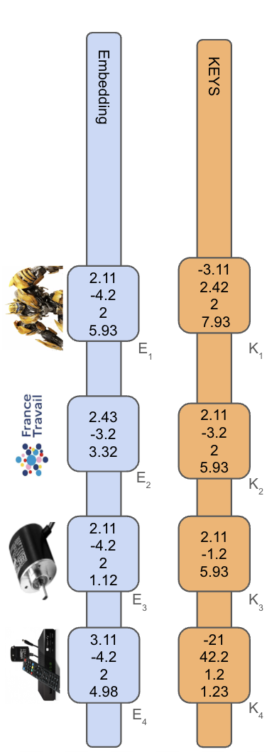
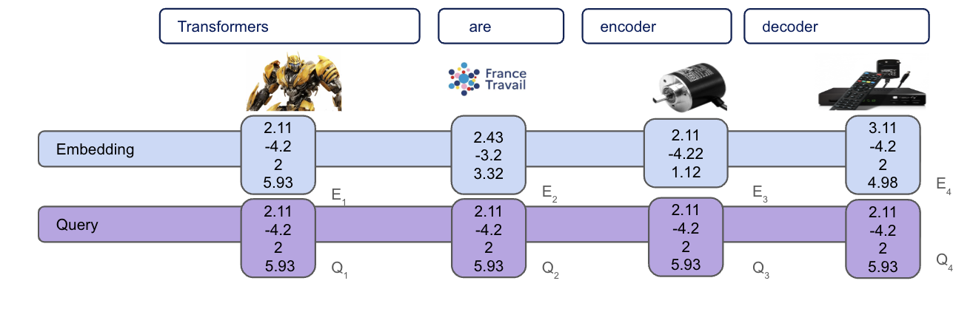
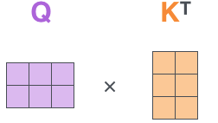
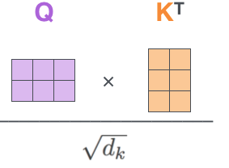
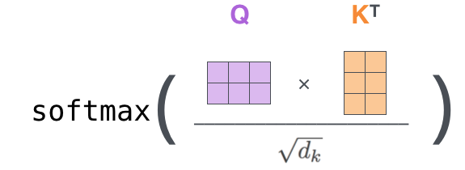
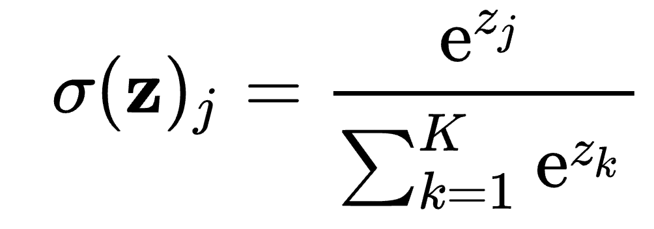
II.B.1 Self Attention Mechanism
The sum of each column is 1
This step allows numerical stability
4 | 70 | 0 | 85
-4 | -10 | 0 | 0
2 | 0 | 0 | 0
3 | -3 | 4 | 5
4/128 | 70/128 | 0 | 85/128
-4/128 | -10 | 0 | 0
2/128 | 0 | 0 | 0
3/128 | -3/128 | 4/128 | 5/128
1 | 0.97 | 0.33 | 0.85
0 | 0.03 | 0.33 | 0.02
0 | 0 | 0.33 | 0.02
0 | 0 | 0 | 0.11
Q₁
Q₂
Q₃
Q₄
Q₁
Q₂
Q₃
Q₄
K₁
Softmax
K₁
Q₁.K₁ | Q₂.K₁ | Q₃.K₁ | Q₄.K₁
Q₁.K₂ | Q₂.K₂ | Q₃.K₂ | Q₄.K₂
Q₁.K₃ | Q₂.K₃ | Q₃.K₃ | Q₄.K₃
Q₁.K₄ | Q₂.K₄ | Q₃.K₄ | Q₄.K₄
Q₁.K₁/√d_{k} | Q₂.K₁/√d_{k} | Q₃.K₁/√d_{k} | Q₄.K₁/√d_{k}
Q₁.K₂/√d_{k} | Q₂.K₂/√d_{k} | Q₃.K₂/√d_{k} | Q₄.K₂/√d_{k}
Q₁.K₃/√d_{k} | Q₂.K₃/√d_{k} | Q₃.K₃/√d_{k} | Q₄.K₃/√d_{k}
Q₁.K₄/√d_{k} | Q₂.K₄/√d_{k} | Q₃.K₄/√d_{k} | Q₄.K₄/√d_{k}
K₂
K₂
K₃
K₃
K₄
K₄

Slide 20
II.B.1 Masking attention Mechanism
Definition: the masking mechanism allows later words to not influence earlier words by setting lower left values by -∞
Idea: A later word cannot answer question to a previous word because it is unknown at inference
This step allows numerical stability
4 | 70 | 0 | 85
-∞ | -10 | 0 | 0
-∞ | -∞ | 0 | 0
-∞ | -∞ | -∞ | 5
4/128 | 70/128 | 0 | 85/128
-∞ | -10 | 0 | 0
-∞ | -∞ | 0 | 0
-∞ | -∞ | -∞ | 5/128
1 | 0.97 | 0.33 | 0.85
0 | 0.03 | 0.33 | 0.02
0 | 0 | 0.33 | 0.02
0 | 0 | 0 | 0.11

Slide 21
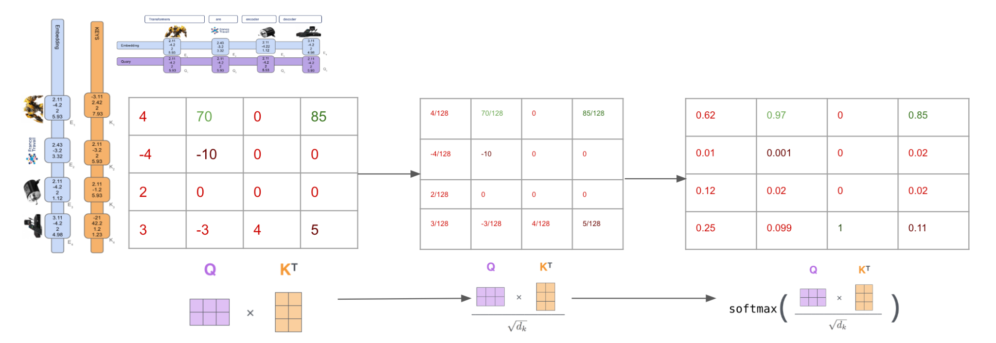
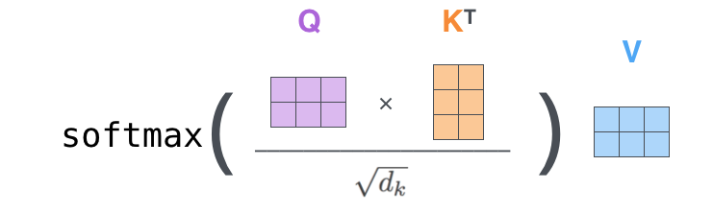
II.B.1 Self Attention Mechanism
Transformers
are
encoder
decoder
2.11
-4.22
5.93
2.43
-3.2
3.32
2.11
-4.22
1.12
3.11
-4.22
4.98
Embedding
E₁
E₂
E₃
E₄
W_{v}
2.11
-4.22
5.93
-3.11
2.422
7.93
1x V₁ | 0.97 x V₁ | 0.33 x V₂ | 0.85 x V₁
0 x V₂ | 0.03 x V₂ | 0.33 x V₂ | 0.02 x V₂
0 x V₃ | 0 x V₃ | 0.33 x V₃ | 0.02x V₃
0 x V₄ | 0 x V₄ | 0 x V₄ | 0.11 x V₄
1.23 | -1.23 | 0.89 | 1.12
2..29 | 3.23 | -3.23 | -3.34
2.83 | 0.92 | 1.10 | 4.28
E₁
V₁
Embedding
VALUES
2.43
-3.2
3.32
2.11
-3.22
5.93
E₂
V₂
2.11
-4.22
1.12
2.11
-1.2
5.93
E₃
V₃
3.11
-4.22
4.98
-21
42.21.2
1.23
E₄
V₄

Slide 22
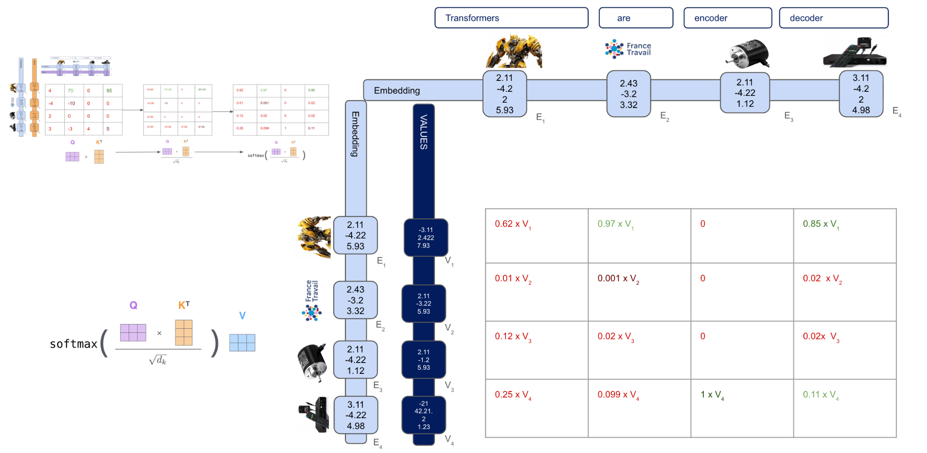
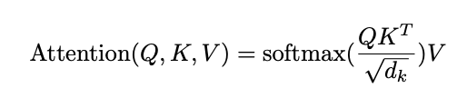
II.B.1 Self Attention Mechanism
Values: What do I reveal to others ?
|E| : Embedding (1, 1512)
|W_{V}|: Value matrix (12 288, 12 288)
ᐩ
ᐩ
ᐩ
ᐩ
Attention pattern
z₁
z₂
z₃
z₄

Slide 23
II.B.2 Self Attention Mechanism
This step allows numerical stability
4 | 70 | 0 | 85
-∞ | -10 | 0 | 0
-∞ | -∞ | 0 | 0
-∞ | -∞ | -∞ | 5
4/128 | 70/128 | 0 | 85/128
-∞ | -10 | 0 | 0
-∞ | -∞ | 0 | 0
-∞ | -∞ | -∞ | 5/128
1 | 0.97 | 0.33 | 0.85
0 | 0.03 | 0.33 | 0.02
0 | 0 | 0.33 | 0.02
0 | 0 | 0 | 0.11
Q₁
Q₂
Q₃
Q₄
Q₁
Q₂
Q₃
Q₄
K₁
Softmax
K₁
Q₁.K₁ | Q₂.K₁ | Q₃.K₁ | Q₄.K₁
Q₁.K₂ | Q₂.K₂ | Q₃.K₂ | Q₄.K₂
Q₁.K₃ | Q₂.K₃ | Q₃.K₃ | Q₄.K₃
Q₁.K₄ | Q₂.K₄ | Q₃.K₄ | Q₄.K₄
Q₁.K₁/√d_{k} | Q₂.K₁/√d_{k} | Q₃.K₁/√d_{k} | Q₄.K₁/√d_{k}
Q₁.K₂/√d_{k} | Q₂.K₂/√d_{k} | Q₃.K₂/√d_{k} | Q₄.K₂/√d_{k}
Q₁.K₃/√d_{k} | Q₂.K₃/√d_{k} | Q₃.K₃/√d_{k} | Q₄.K₃/√d_{k}
Q₁.K₄/√d_{k} | Q₂.K₄/√d_{k} | Q₃.K₄/√d_{k} | Q₄.K₄/√d_{k}
K₂
K₂
K₃
K₃
K₄
K₄

Slide 24
II.B.2 Cross attention
Transformers
are
encoder
decoder
2.11
-4.22
5.93
2.43
-3.2
3.32
2.11
-4.22
1.12
3.11
-4.22
4.98
Embedding
E₁
E₂
E₃
E₄
2.11
-4.22
5.93
2.11
-4.22
5.93
2.11
-4.22
5.93
2.11
-4.22
5.93
Query
Q₁
Q₂
Q₃
Q₄
Les
2.11
-4.22
5.93
-3.11
2.422
7.93
E₁
K₁
70 | 70 | 0 | 85
-4 | 35 | 0 | 0
2 | 0 | 30 | 0
3 | -3 | 4 | 18
… | … | … | …
Transformers
Embedding
KEYS
2.43
-3.2
3.32
2.11
-3.22
5.93
French to english translation example
No masking
E₂
K₂
sont
2.11
-4.22
1.12
2.11
-1.2
5.93
E₃
K₃
des
3.11
-4.22
4.98
-21
42.21.2
1.23
E₄
K₄
…

Slide 25
II.B.2 Cross attention

Slide 26
II.B.1 Self Attention Mechanism
GPT 3 dimension for one attention head
Query: What am I looking for ?
|E| : Embedding (1, 12 288)
|W_{Q}|: Query matrix (12 288, 128)
Key: What do I have ?
|E| : Embedding (1, 12 288)
|W_{K}|: Query matrix (12 288, 128)
Values: What do I reveal to others ?
|E| : Embedding (1, 1512)
|W_{V}|: Value matrix (12 288, 12 288)
Embedding | (Embedding Dimension, N words) | (12 288, 50 257) | 49 152 params
Key | (Key size, Embedding Dimension) | (128, 12 288) | 1 572 864 params per head
Query | (Query size, Embedding Dimension) | (128, 12 288) | 1 572 864 params per head
Value up | (Value size, Embedding Dimension) | (128, 12 288) | 1 572 864 params per head
Value down | (Embedding Dimension, Value size) | (12 288, 128) | 1 572 864 params per head

Slide 27
II.B.1 Self Attention Mechanism
GPT 3 dimension for all attention heads: 603 979 776 parameters
Query: What am I looking for ?
|E| : Embedding (1, 12 288)
|W_{Q}|: Query matrix (12 288, 128)
Key: What do I have ?
|E| : Embedding (1, 12 288)
|W_{K}|: Query matrix (12 288, 128)
Values: What do I reveal to others ?
|E| : Embedding (1, 1512)
|W_{V}|: Value matrix (12 288, 12 288)
Embedding | (Embedding Dimension, N words) | (12 288, 4) | 49 152 params
Key | (Key size, Embedding Dimension) | (128, 12 288) x 96 heads | 150 994 944 params
Query | (Query size, Embedding Dimension) | (128, 12 288) x 96 heads | 150 994 944 params
Value up | (Value size, Embedding Dimension) | (128, 12 288) x 96 heads | 150 994 944 params
Value down | (Embedding Dimension, Value size) | (12 288, 128) x 96 heads | 150 994 944 params

Slide 28
II.B.1 Self Attention Mechanism
Value Matrix (12 288, 12 288) decomposition≈
Idea:
The number of # is 150m for the Value matrix
To avoid this high dimension and respects the
Force the Value matrix to be low rank
128
12 288
0.8 | 0.2
0.3 | 1.7
-1.3 | 3.2
3.2 | 0.32
12 288
1.2 | 0.23 | -2.3 | 3.23
0.32 | -4.31 | 2.11 | 0.12
2.33 | -2.32 | 0.23 | -0.23
-1.76 | 0.21 | 0.92 | -0.12
=
1 | 0.97 | 0.33 | 0.85
0 | 0.03 | 0.33 | 0.02
128
12 288
12 288

Slide 29
II.B.1 Multi
Value Matrix (12 288, 12 288) decomposition
Idea:
The number of # is 150m for the Value matrix
To avoid this high dimension and respects the
Force the Value matrix to be low rank
128
12 288
0.8 | 0.2
0.3 | 1.7
-1.3 | 3.2
3.2 | 0.32
12 288
1.2 | 0.23 | -2.3 | 3.23
0.32 | -4.31 | 2.11 | 0.12
2.33 | -2.32 | 0.23 | -0.23
-1.76 | 0.21 | 0.92 | -0.12
=
1 | 0.97 | 0.33 | 0.85
0 | 0.03 | 0.33 | 0.02
128
12 288
12 288

Slide 30
II.B.1 Self Attention Mechanism
Value Matrix (12 288, 12 288) decomposition
Idea:
The number of # is 150m for the Value matrix
To avoid this high dimension and respects the
Force the Value matrix to be low rank
128
12 288
0.8 | 0.2
0.3 | 1.7
-1.3 | 3.2
3.2 | 0.32
12 288
1.2 | 0.23 | -2.3 | 3.23
0.32 | -4.31 | 2.11 | 0.12
2.33 | -2.32 | 0.23 | -0.23
-1.76 | 0.21 | 0.92 | -0.12
=
.
1 | 0.97 | 0.33 | 0.85
0 | 0.03 | 0.33 | 0.02
128
12 288
12 288
W_{v}

Slide 31
II.B.1 Self Attention Mechanism
Value Matrix computation optimization
0.62 x V₁ | 0.97 x V₁ | 0 x V₂ | 0.85 x V₁
0 x V₂ | 0.001 x V₂ | 0 x V₂ | 0.02 x V₂
0 x V₃ | 0 x V₃ | 0 x V₃ | 0.02x V₃
0 x V₄ | 0 x V₄ | 0 x V₄ | 0.11 x V₄
12 288
E₁
0.32 3.02 … -0.33
0.65
0.3
0.23
0.4
1.2 | 0.23 | -2.3 | 3.23
0.32 | -4.31 | 2.11 | 0.12
2.33 | -2.32 | 0.23 | -0.23
-1.76 | 0.21 | 0.92 | -0.12
.
=
= V₁
12 288
12 288
W_{v}

Slide 32
II.B.1 Self Attention Mechanism
Method 1 W_{V} (12 288, 12 288)
0.62 x V₁ | 0.97 x V₁ | 0 x V₂ | 0.85 x V₁
0.1 x V₂ | 0.001 x V₂ | 0 x V₂ | 0.02 x V₂
0 x V₃ | 0 x V₃ | 0 x V₃ | 0.02x V₃
0 x V₄ | 0 x V₄ | 0 x V₄ | 0.11 x V₄
Number of computations:
N words x 12 288 multiplications
N words x 12 288 additions
0.62 x V₁
0.1 x V₂
0 x V₃
0 x V₄
0.1 x v₂₁ 0.1 x v₂₂ … 0.1 x v_{2, 12288}
0.32 x 0.62 3.02 x 0.62 … -0.33 x 0.62
+
…
=
12 288
12 288

Slide 33
II.B.1 Self Attention Mechanism
Method 1 W_{V} (12 288, 128)
0.62 x V₁ | 0.97 x V₁ | 0 x V₂ | 0.85 x V₁
0.1 x V₂ | 0.001 x V₂ | 0 x V₂ | 0.02 x V₂
0 x V₃ | 0 x V₃ | 0 x V₃ | 0.02x V₃
0 x V₄ | 0 x V₄ | 0 x V₄ | 0.11 x V₄
Step 2:
Number of computations:
N words x 128 multiplications
N words x 128 additions
Matrix multiplication between value up matrix and result:
128 multiplication + 128 addition for each row
12 288 times
0.62 x V₁
0.1 x V₂
0 x V₃
0 x V₄
0.1 x v₂₁ 0.1 x v₂₂ … 0.1 x v_{2, 128}
0.32 x 0.62 3.02 x 0.62 … -0.33 x 0.62
+
…
=
128
128

Slide 34
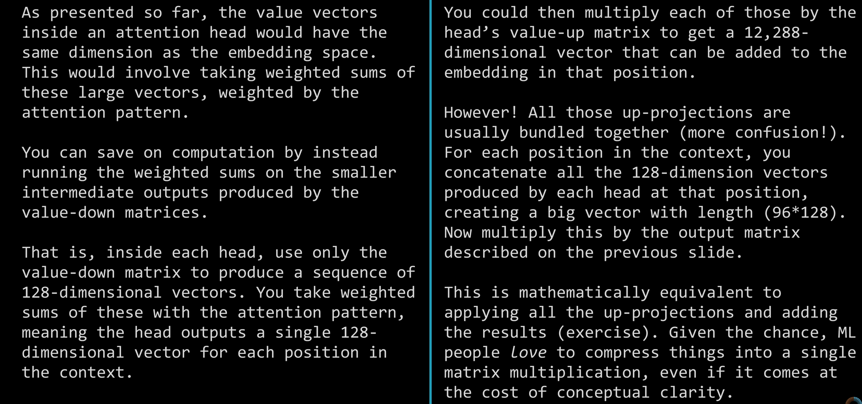

Slide 35
II.B. Transformers Architecture
Introduction
Self Attention / Cross Attention
Multi-Head Attention
Residual connection & Layer normalization
Feed forward layer
Softmax Layer
Positional Embeddings

Slide 36
II.B.2 Multi-Head Attention
Transformers
are
encoder
decoder
Attention mechanism

Slide 37
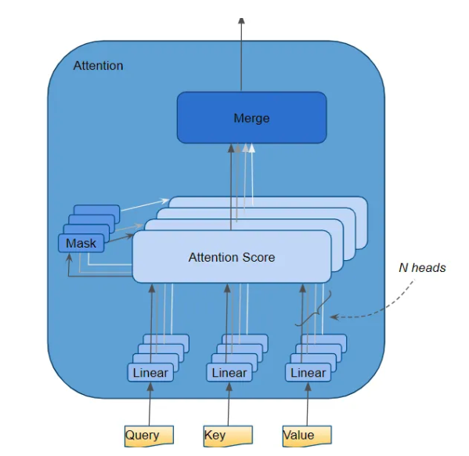
II.B.2 Multi-Head attention
ᐩ
ᐩ
ᐩ
ᐩ
z₁
z₂
z₃
z₄
N words
Z
|V| (=128)
z₁
z₂
z₃
z₄

Slide 38
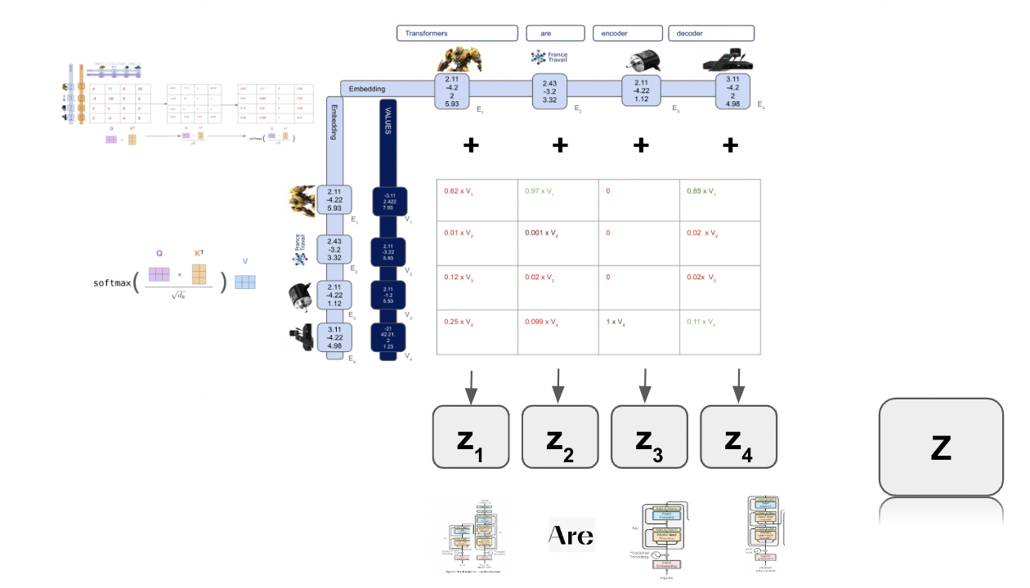
II.B.2 Multi-Head attention
N words
z₁
…
z₁
…
z₂
Concatenation
z₁₀
z₃
|V| x N heads
= 128 x 96
z₉₆
z₉₆

Slide 39
II.B.2 Multi-Head attention
N words
| Embeddings Dim|
W₀
…
z₁
x
Z
| Embeddings Dim|
z₁₀
|V| x N heads
= 128 x 96
|V| x N heads
N words
z₉₆

Slide 40
II.B.2 Multi-Head attention - Summary exercice
3
Step 3
Input sentence: Transformers are encoder decoder
|Key Dim| = |Query Dim| = |Value Dim| = 3
|Embedding Dim| = 5
|N words| = 4
Z₀
4
5
3
W^{Q}₀
3
Q₀
W^{K}₀
Transformers
are
encoder
decoder
K₀
W^{V}₀
4
V₀
5
4
Step 1
Step 2

Slide 41
II.B.2 Multi-Head attention - Summary exercice
W^{Q}₀
Q₀
W^{K}₀
K₀
Z₀
W^{V}₀
V₀
Step 4
…
…
…
W^{Q}₉₆
Q₉₆
W^{K}₉₆
K₉₆
Z₉₆
W^{V}₉₆
V₉₆

Slide 42
II.B.2 Multi-Head attention - Summary exercice
3
Z₀
3
5
4
W₀
Z
5
4
…
4 x 96
4 x 96
3
Z₉₆
4
Step 5
Matmul

Slide 43
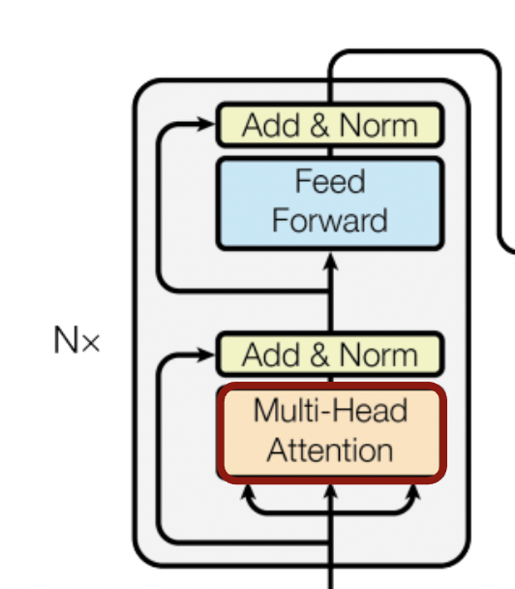
II.B.2 Multi-Head attention - Summary exercice
Why do Z and X have the same dimension ?
5
X
Transformers
are
encoder
decoder
4
5
Z
4

Slide 44
II.B. Transformers Architecture
Introduction
Self Attention / Cross Attention
Multi-Head Attention
Residual connection & Layer normalization
Feed forward layer
Softmax Layer
Positional Embeddings

Slide 45
II.B.3. Residual connections & Layer normalization

Slide 46
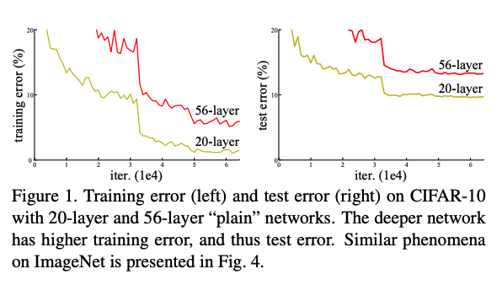
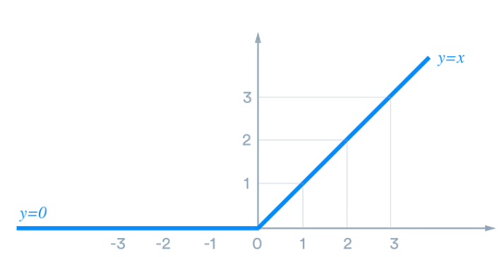
II.B.3. Residual connections & Layer normalization
Residual connections
Residual connections mainly help mitigate the vanishing gradient problem
Another effect of residual connections is that the information stays local in the Transformer layer stack
ReLU
y = max(x, 0)
He & Al, 2015, Deep Residual Learning for Image Recognition
Notes:
Pendant la backpropagation, les signaux sont multiplié par la dérivée de la fonction d’activation.
Dans le cas de la RELU, une fois sur deux, la dérivée est à 0. La plupart des signés vont donc être à 0 et plus on repart dans les première couches, plus le signal est faible et la mise à jour des poids est inefficace.
La residual connection consiste à ajouter l’input du block précédent par une somme.
Cette somme est linéaire par rapport au gradient et chaque block recoit dpnc un signal qui n’est pas impacté par le vanishing gradient car il ne contient pas toutes les dérivées successives.
Faire schema au tableau deep, shallow and residual LOSS
Dans un autre sens, les residual connections donnent la garantie que la representation textuelle des tokens représente bien celle des tokens et que l’information reste local au niveau de chaque block

Slide 47
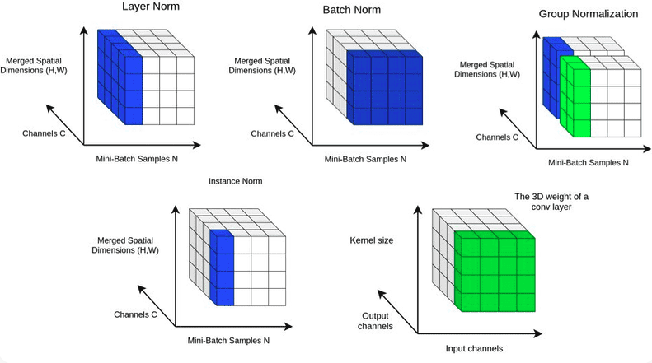
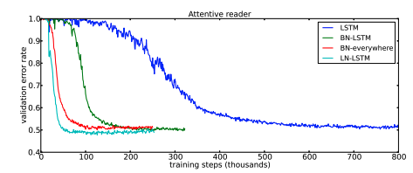
II.B.3. Residual connections & Layer normalization
Layer normalization
“Layer normalization is very effective at stabilizing the hidden state dynamics in recurrent networks.
Empirically, we show that layer normalization can substantially reduce the training time compared with previously published techniques.”
Hinton & Al, 2016, Layer Normalization
2020, In-layer normalization techniques for training very deep neural networks [Blog]
Notes:
Pendant la backpropagation, les signaux sont multiplié par la dérivée de la fonction d’activation.
Dans le cas de la RELU, une fois sur deux, la dérivée est à 0. La plupart des signés vont donc être à 0 et plus on repart dans les première couches, plus le signal est faible et la mise à jour des poids est inefficace.
La residual connection consiste à ajouter l’input du block précédent par une somme.
Cette somme est linéaire par rapport au gradient et chaque block recoit dpnc un signal qui n’est pas impacté par le vanishing gradient car il ne contient pas toutes les dérivées successives.
Faire schema au tableau deep, shallow and residual LOSS
Dans un autre sens, les residual connections donnent la garantie que la representation textuelle des tokens représente bien celle des tokens et que l’information reste local au niveau de chaque block

Slide 48
So far …

Slide 49
II.B. Transformers Architecture
Introduction
Self Attention / Cross Attention
Multi-Head Attention
Residual connection & Layer normalization
Feed forward layer
Softmax Layer
Positional Embeddings
Optimization

Slide 50
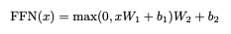
II.B.4. Feed forward layer
“In addition to attention sub-layers, each of the layers in our encoder and decoder contains a fully connected feed-forward network, which is applied to each position separately and identically. This consists of two linear transformations with a ReLU activation in between.”
‘Up
projection’
‘Down
projection’

Slide 51
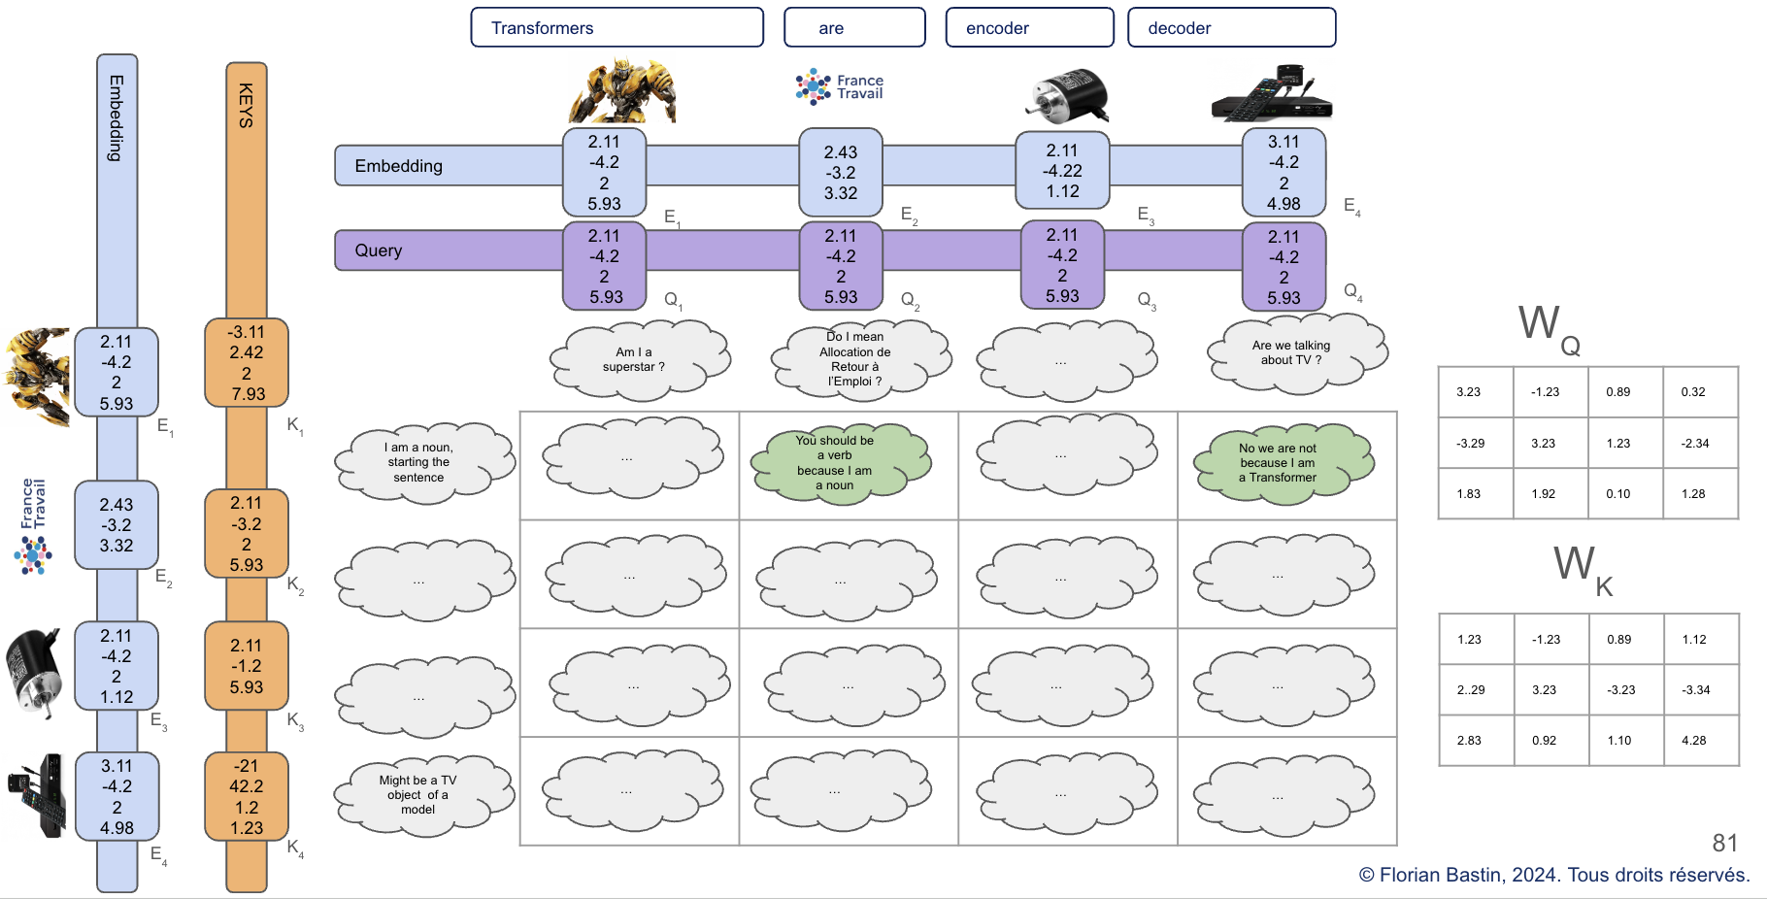
II.B.4. Feed forward layer
Feed forward layer
5
X
Transformers
are
encoder
decoder
4
Transformers: “I am related to maths stuff, a plural noun, at the beginning of the sentence”
5
Z
Decoder: “I am before encoder, maybe related to maths, maybe an architecture
4

Slide 52
II.B.4. Feed forward layer
Feed forward layer
5
X
Transformers
are
encoder
decoder
4
Residual connection + Layer Nom
Feed forward
Layer
Z
Transformers: “I am related to maths stuff, a plural noun, at the beginning of the sentence”
5
Decoder: “I am before encoder, maybe related to maths, maybe an architecture
4

Slide 53
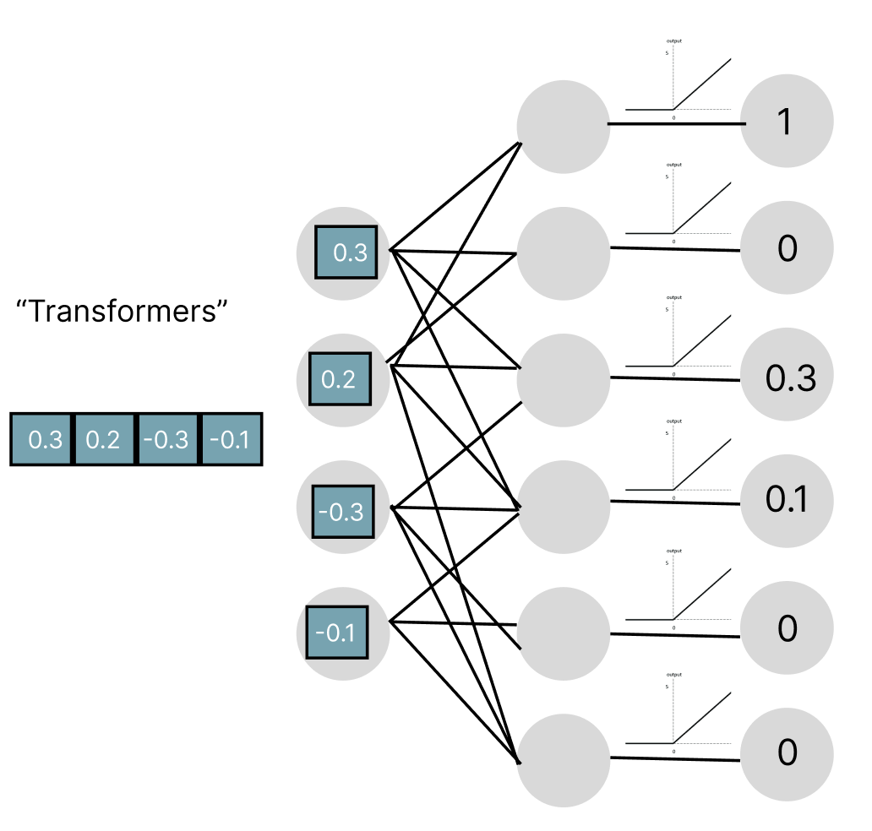
II.B.4. Feed forward layer
Feed forward layer
Feed forward network
Feed forward network
Am I a math architecture ?
Transformers: “I am related to maths stuff, a plural noun, at the beginning of the sentence”
5
Am I a plural noun ?
Decoder: “I am before encoder, maybe related to maths, maybe an architecture
4
…
Am I a football star ?
…

Slide 54
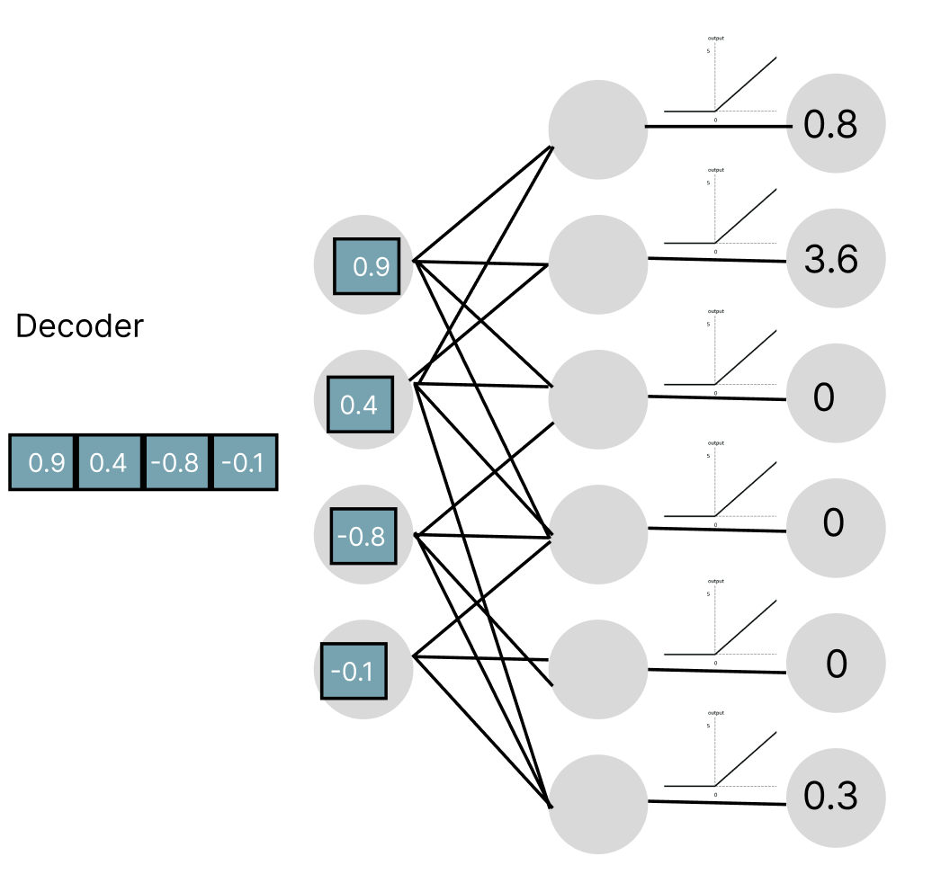
II.B.4. Feed forward layer
Feed forward layer
Feed forward network
Am I a math architecture ?
Transformers: “I am related to maths stuff, a plural noun, at the beginning of the sentence”
5
Am I a singular noun ?
Decoder: “I am before encoder, maybe related to maths, maybe an architecture
4
…
Am I a TV stuff ?
…

Slide 55
II.B.4. Feed forward layer
Feed forward layer : “Up projection”
Feed forward network
Up projection dimension = 49 152 x embedding dimension
49 152
…

Slide 56
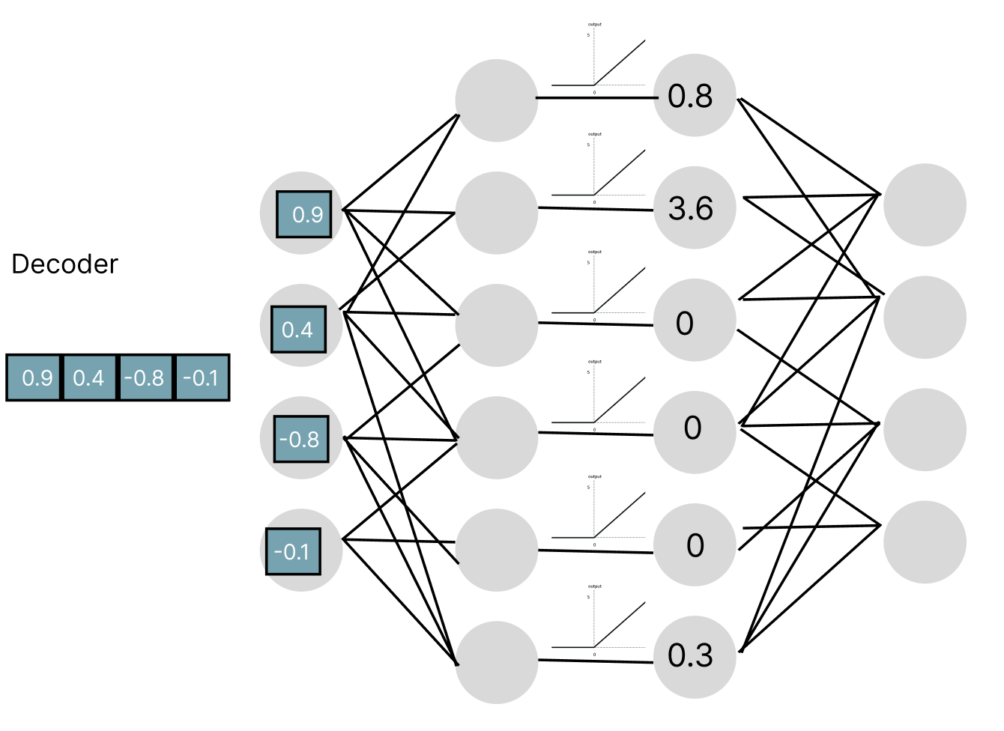
II.B.4. Feed forward layer
Feed forward layer : “Down projection”
Another layer
Down projection dimension = embedding dim x 49 152
12 288

Slide 57
II.B.4. Feed forward layer
GPT 3 dimension per layer
Embedding | (Embedding Dimension, N words) | (12 288, 50 257) | 617 558 016 params
Key | (Key size, Embedding Dimension) | (128, 12 288) x 96 heads | 150 994 944 params
Query | (Query size, Embedding Dimension) | (128, 12 288) x 96 heads | 150 994 944 params
Value up | (Value size, Embedding Dimension) | (128, 12 288) x 96 heads | 150 994 944 params
Value down | (Embedding Dimension, Value size) | (12 288, 128) x 96 heads | 150 994 944 params
Up Projection | (Neuron Dim, Embedding Dimension) | (49 152, 12 288) | 603 979 776 params
Down Projection | (Embedding Dimension, Neuron Dim) | (12 288, 49 152) | 603 979 776 params
Unembedding | (N words, Embedding Dimension) | (50 257, 12 288) | 617 558 016

Slide 58
II.B.4. Feed forward layer
GPT 3 dimension (96 layers):
Embedding | (Embedding Dimension, N words) | (12 288, 50 257) | 617 558 016 params
Key | (Key size, Embedding Dimension) | (128, 12 288) x 96 heads x 96 layers | 14 495 514 624 params
Query | (Query size, Embedding Dimension) | (128, 12 288) x 96 heads x 96 layers | 14 495 514 624 params
Value up | (Value size, Embedding Dimension) | (128, 12 288) x 96 heads x 96 layers | 14 495 514 624 params
Value down | (Embedding Dimension, Value size) | (12 288, 128) x 96 heads x 96 layers | 14 495 514 624 params
Up Projection | (Neuron Dim, Embedding Dimension) | (49 152, 12 288) x 96 layers | 57 982 058 496 params
Down Projection | (Embedding Dimension, Neuron Dim) | (12 288, 49 152) x 96 layers | 57 982 058 496 params
Unembedding | (N words, Embedding Dimension) | (50 257, 12 288) | 617 558 016 params

Slide 59
So far …

Slide 60
II.B. Transformers Architecture
Introduction
Self Attention / Cross Attention
Multi-Head Attention
Residual connection & Layer normalization
Feed forward layer
Softmax Layer
Positional Embeddings

Slide 61
II.B.5. Softmax Layer
“Similarly to other sequence transduction models, we use learned embeddings to convert the input tokens and output tokens to vectors of dimension d_{model} .
We also use the usual learned linear transformation and softmax function to convert the decoder output to predicted next-token probabilities.
In our model, we share the same weight matrix between the two embedding layers and the pre-softmax linear transformation, similar to [30]. In the embedding layers, we multiply those weights by √ d_{model} .”

Slide 62
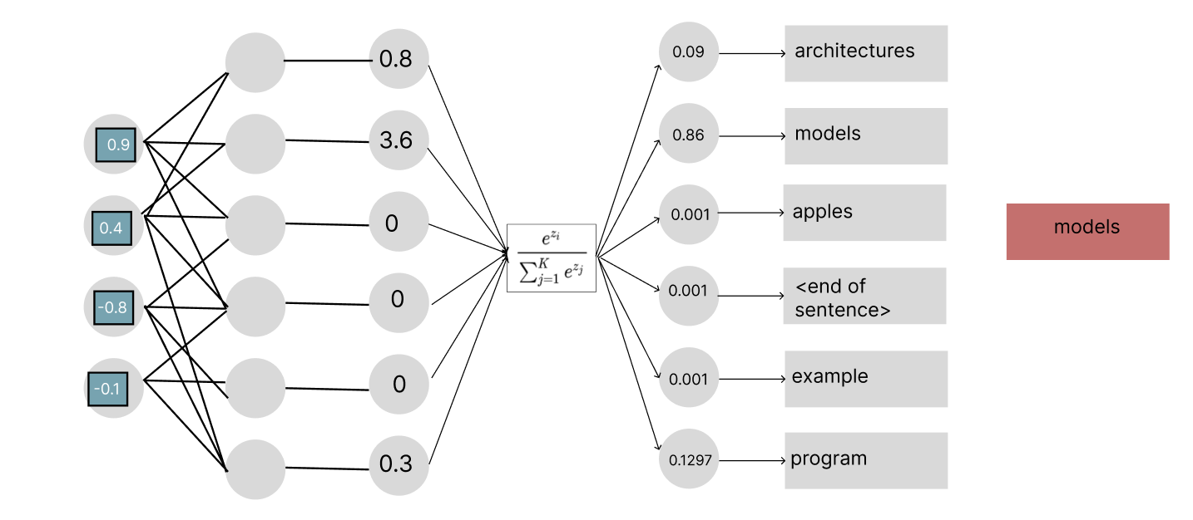
II.B.5. Softmax Layer
The input is he vector from the last word of the sentence
The output is the probability distribution over all words in the dictionary (50k words for GPT 3-
Notes:
On verra ensuite comment fonctionne ce fameux modèle abstrait jusqu’ici

Slide 63
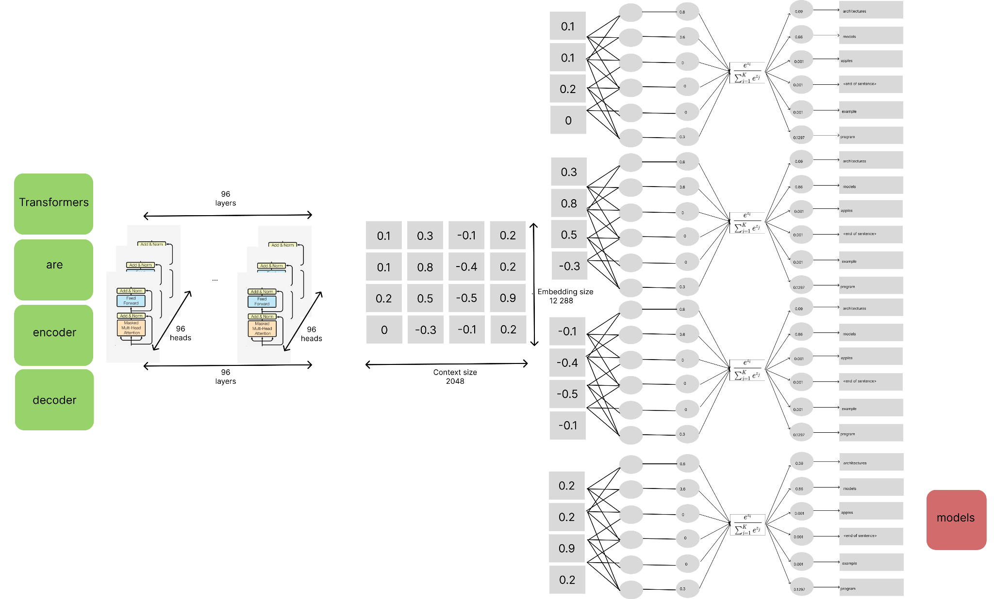
II.B.5. Softmax Layer
Q. Why don’t we take all the previous representations of the other vectors for the inference ?
are
For training, each word/token is used for next word prediction. The model is trained to predict next word from only its previous word.
Of course, the last word context is learned with attention
encoder
decoder
Notes:
On verra ensuite comment fonctionne ce fameux modèle abstrait jusqu’ici

Slide 64
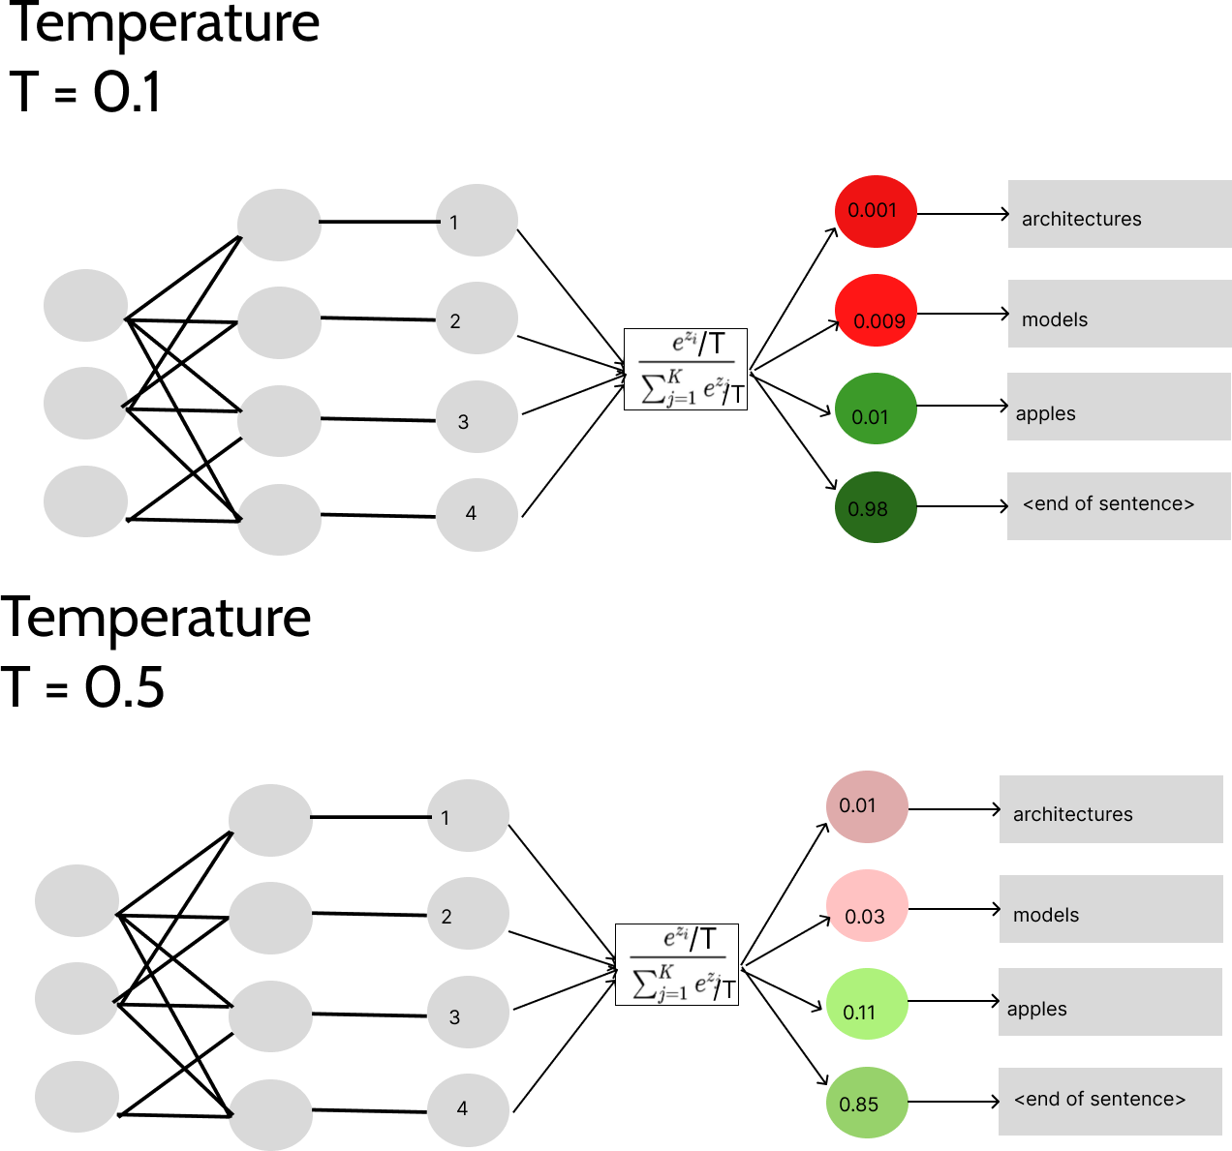
II.B.5 II.B.5. Softmax Layer - Temperature
Notes:
On verra ensuite comment fonctionne ce fameux modèle abstrait jusqu’ici

Slide 65
II.B.5. Softmax Layer
GPT 3 dimension (96 layers):
175 181 291 520 trainable parameters
Embedding | (Embedding Dimension, N words) | (12 288, 50 257) | 617 558 016 params
Key | (Key size, Embedding Dimension) | (128, 12 288) x 96 heads x 96 layers | 14 495 514 624 params
Query | (Query size, Embedding Dimension) | (128, 12 288) x 96 heads x 96 layers | 14 495 514 624 params
Value up | (Value size, Embedding Dimension) | (128, 12 288) x 96 heads x 96 layers | 14 495 514 624 params
Value down | (Embedding Dimension, Value size) | (12 288, 128) x 96 heads x 96 layers | 14 495 514 624 params
Up Projection | (Neuron Dim, Embedding Dimension) | (49 152, 12 288) x 96 layers | 57 982 058 496 params
Down Projection | (Embedding Dimension, Neuron Dim) | (12 288, 49 152) x 96 layers | 57 982 058 496 params
Unembedding | (N words, Embedding Dimension) | (50 257, 12 288) | 617 558 016 params

Slide 66
So far …

Slide 67
II.B. Transformers Architecture
Introduction
Self Attention / Cross Attention
Multi-Head Attention
Residual connection & Layer normalization
Feed forward layer
Softmax Layer
Positional Embeddings

Slide 68
II.B.6. Positional Embeddings
“Since our model contains no recurrence and no convolution, in order for the model to make use of the order of the sequence, we must inject some information about the relative or absolute position of the tokens in the sequence.
To this end, we add "positional encodings" to the input embeddings at the bottoms of the encoder and decoder stacks. The positional encodings have the same dimension d_{model} as the embeddings, so that the two can be summed.”
Notes:
That is, each dimension of the positional encoding corresponds to a sinusoid. The wavelengths form a geometric progression from 2π to 10000 · 2π. We chose this function because we hypothesized it would allow the model to easily learn to attend by relative positions, since for any fixed offset k, P Epos+k can be represented as a linear function of P Epos. We also experimented with using learned positional embeddings [9] instead, and found that the two versions produced nearly identical results (see Table 3 row (E)). We chose the sinusoidal version because it may allow the model to extrapolate to sequence lengths longer than the ones encountered during training.

Slide 69
II.B.6. Positional Embeddings
Computations are not done sequentially (unlike RNN and LSTM)
How to compare “A B C” and “C A B” ?
Beneficial to find a method that satisfy the following points:
Unambiguous (each position have its own value)
Deterministic
Allows to estimate distance between tokens
Works with longer sequence than seen during training
Notes:
Positional encoding
Les encodages des séquences d'entrée et de sortie sont concaténés avec des encodages positionnels. Ces codages injectent des informations sur les positions relatives des éléments de la séquence.
each position have its own value
Deterministic, representable par une loi avec des relations entre les positions
It could be nice for the model to know how far to token are for each others
Generalization to long sequence

Slide 70
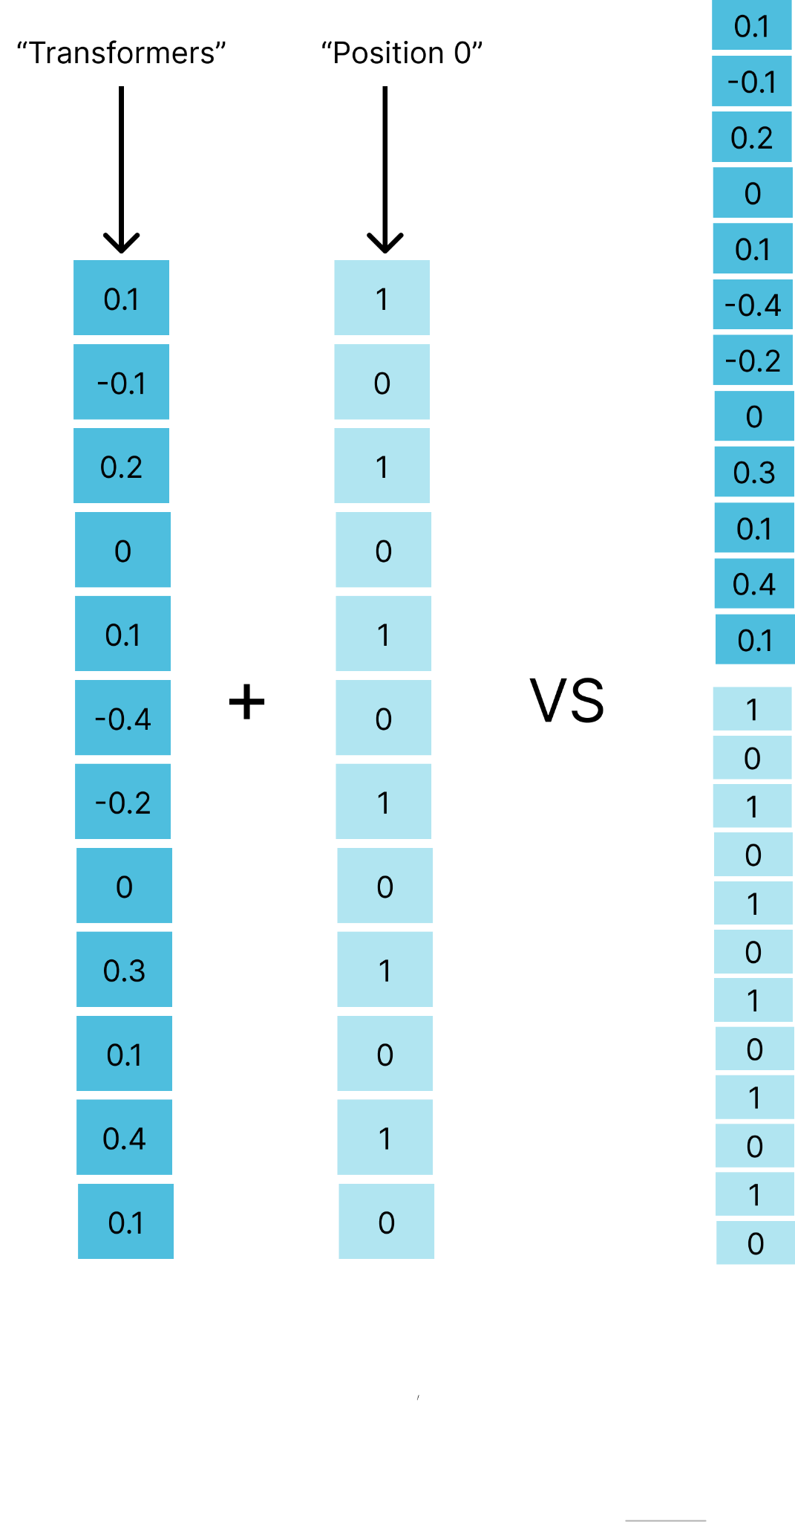
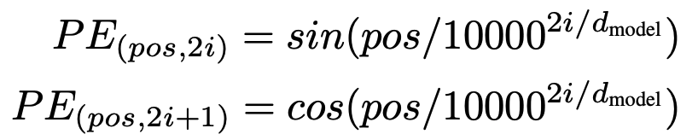
II.B.6. Positional Embeddings
Same size embedding to represent position (computationnaly for efficient that concatenation and model size increase)
Don’t want to allow the model to extract information about positional informations only. Have to be coupled with word meaning
Where:
pos is the position {1, …, context length}
i is the dimension = {1, …, d_{model} }
d_{model} is the embedding dimension (GPT 3 = 12 288)
Notes:
Positional encoding
Les encodages des séquences d'entrée et de sortie sont concaténés avec des encodages positionnels. Ces codages injectent des informations sur les positions relatives des éléments de la séquence.
each position have its own value
Deterministic, representable par une loi avec des relations entre les positions
It could be nice for the model to know how far to token are for each others
Generalization to long sequence

Slide 71
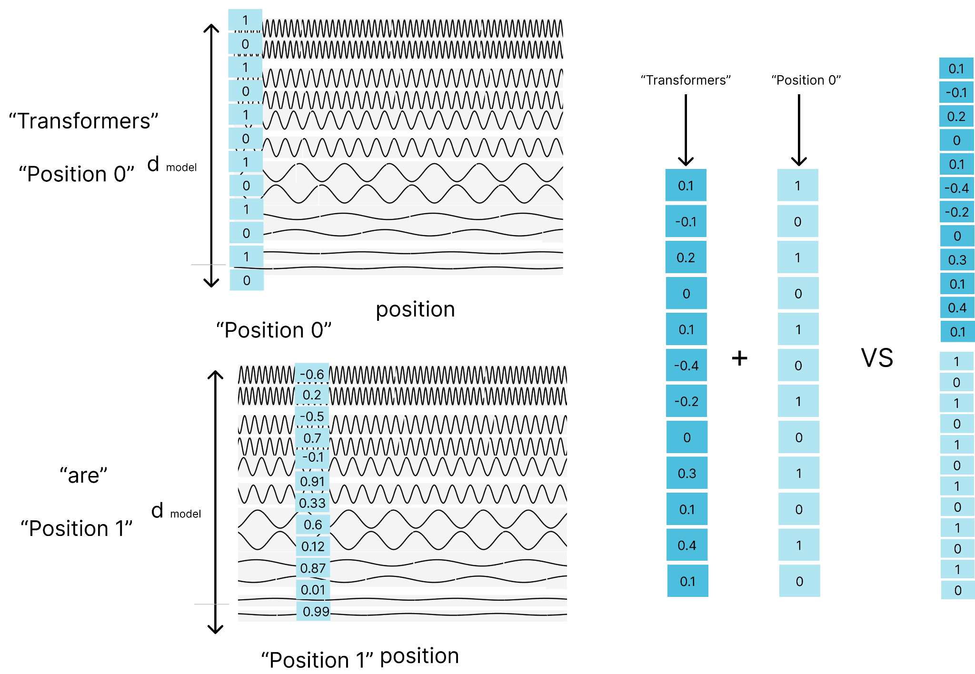
II.B.6. Positional Embeddings
Notes:
Positional encoding
Les encodages des séquences d'entrée et de sortie sont concaténés avec des encodages positionnels. Ces codages injectent des informations sur les positions relatives des éléments de la séquence.

Slide 72
II.B.6. Positional Embeddings
Properties
The positional values are unique if at least one function has maximum size of this sequence (context window) 👌
The positional values are not random, created using two equations 👌
Looking at frequencies, we can estimate distance between positions. For positions near to each other, we can use high frequency functions. For long distance position, we can use function with larger periods. 👌
Since sin and cosine are periodic functions, the model can generalize for longer sequences 👌
Notes:
Positional encoding
Les encodages des séquences d'entrée et de sortie sont concaténés avec des encodages positionnels. Ces codages injectent des informations sur les positions relatives des éléments de la séquence.
each position have its own value
Deterministic, representable par une loi avec des relations entre les positions
It could be nice for the model to know how far to token are for each others
Generalization to long sequence

Slide 73
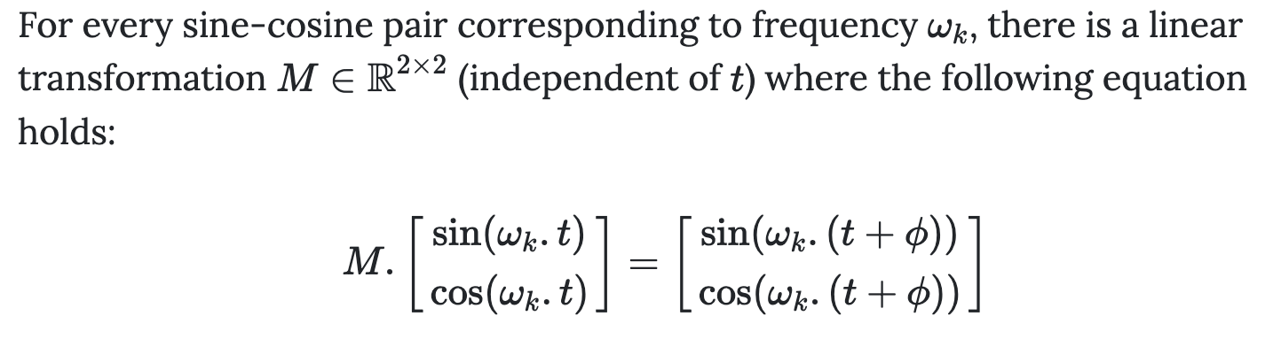
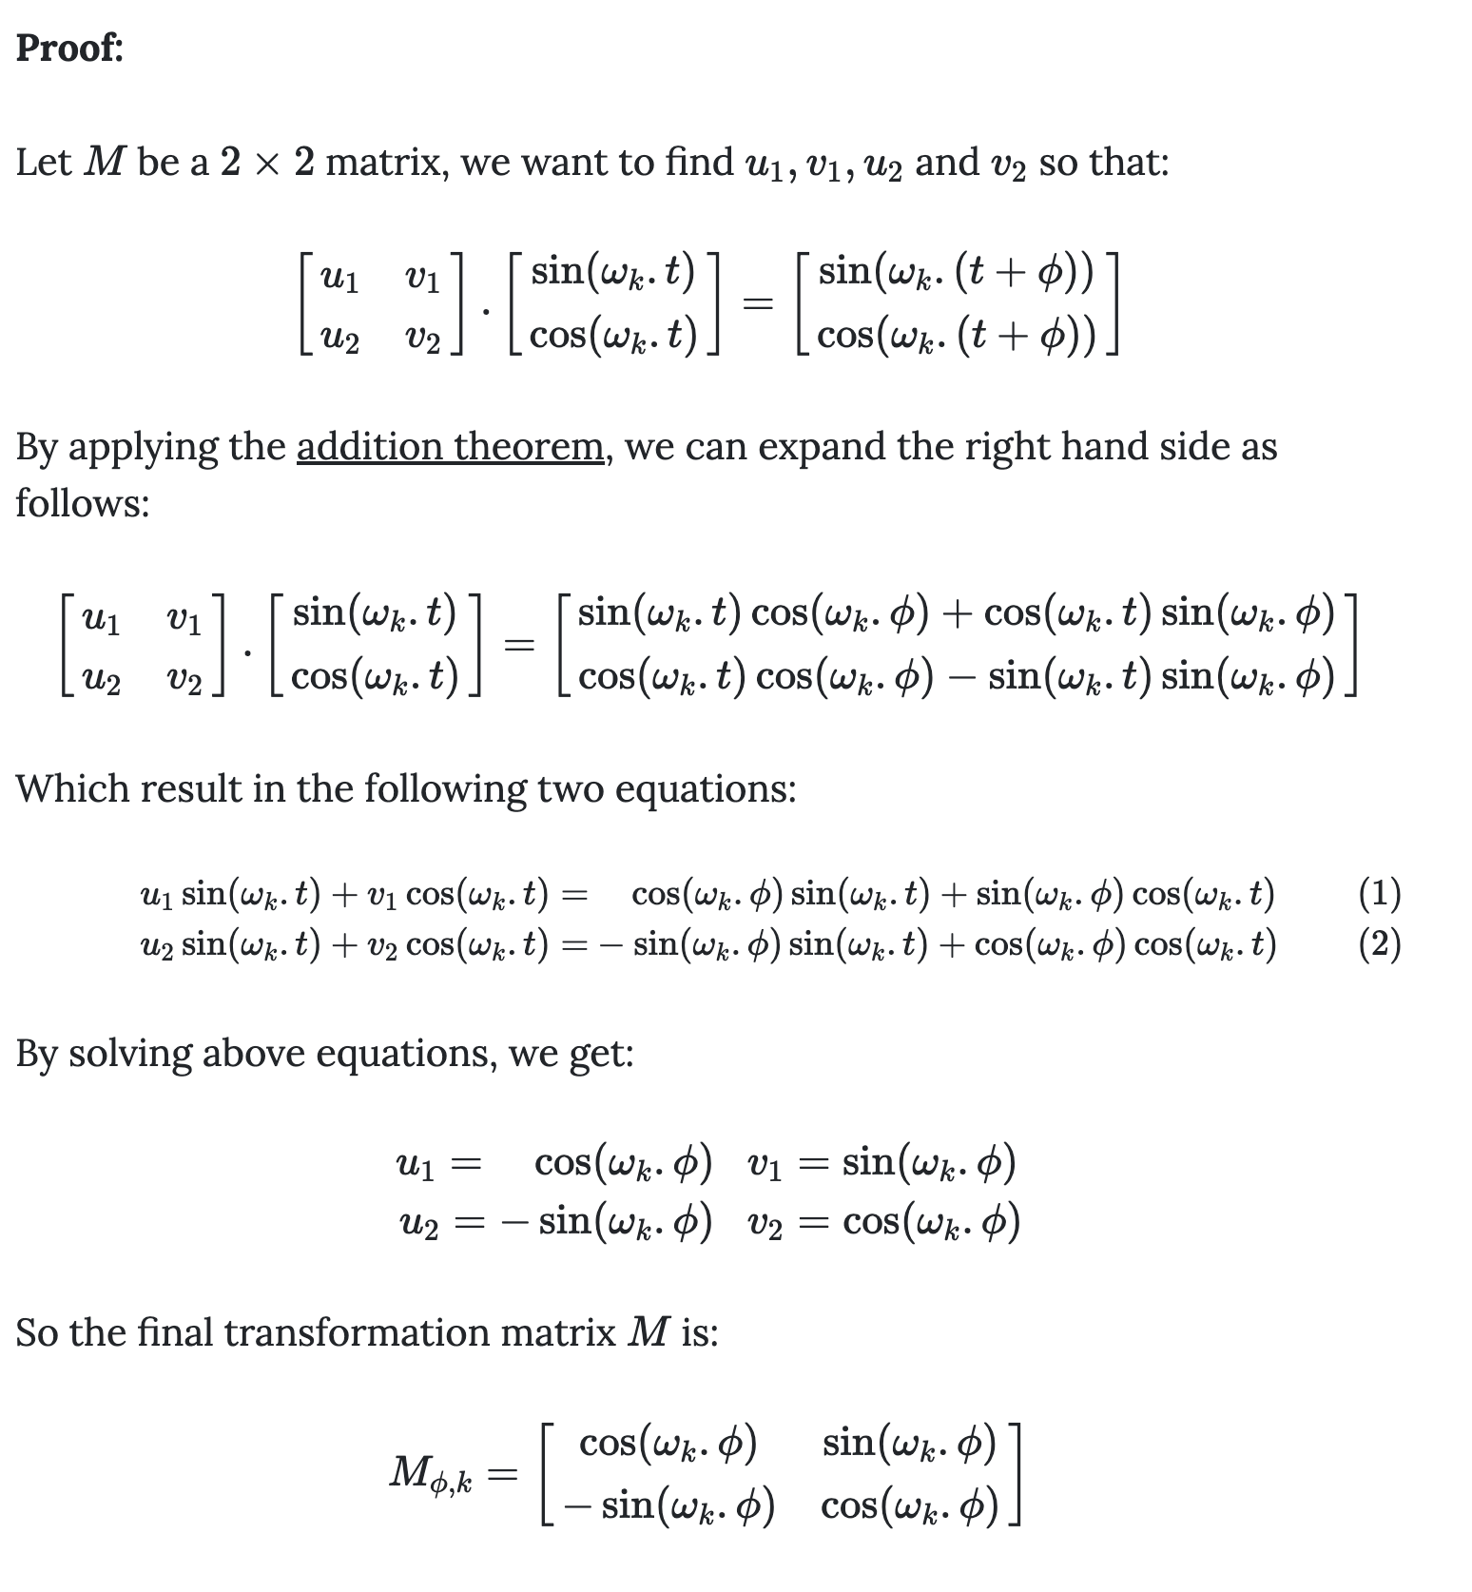
II.B.6. Positional Embeddings
“We chose this function because we hypothesized it would allow the model to easily learn to attend by relative positions, since for any fixed offset k, PE_{pos+k} can be represented as a linear function of PE_{pos}.”
Kazemnejads, 2019, Transformer Architecture: The Positional Encoding [Blog]
Notes:
Positional encoding
Les encodages des séquences d'entrée et de sortie sont concaténés avec des encodages positionnels. Ces codages injectent des informations sur les positions relatives des éléments de la séquence.
each position have its own value
Deterministic, representable par une loi avec des relations entre les positions
It could be nice for the model to know how far to token are for each others
Generalization to long sequence

Slide 74
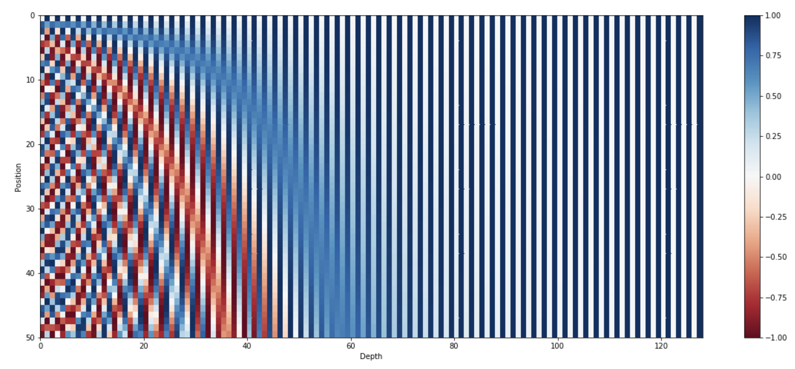
II.B.6. Positional Embeddings
Figure: Positional encoding representation
Each row represent a positional vector for a given token
Kazemnejads, 2019, Transformer Architecture: The Positional Encoding [Blog]
Notes:
Positional encoding
Les encodages des séquences d'entrée et de sortie sont concaténés avec des encodages positionnels. Ces codages injectent des informations sur les positions relatives des éléments de la séquence.
each position have its own value
Deterministic, representable par une loi avec des relations entre les positions
It could be nice for the model to know how far to token are for each others
Generalization to long sequence

Slide 75
So far …

Slide 76
II. Resources
Blogs:
The Illustrated Transformer
Transformers Explained Visually (Part 3): Multi-head Attention, deep dive
Papers:
Attention is All You Need
Videos:
Visual introduction to Transformers (part 1)
Transformers visualized (part 2)
How might LLMs store fact (part 3)
Residual Network and skip connections
Stanford CS25: V2 I Introduction to Transformers w/ Andrej Karpathy
Notes:
On verra ensuite comment fonctionne ce fameux modèle abstrait jusqu’ici

